Slide 1
Embedded System Project
CS- 684
Spring 2018
Self Orienting Smart Chair
Under the guidance of Prof. Kavi Arya and Mr. Lohit
Group Members
Akhilesh Patil (173079005)
Supriya Asutkar (174360005)
Rahul Pari (173100041)

Slide 2
1st Demo

Slide 3
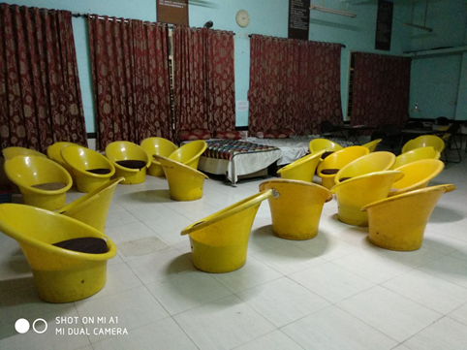
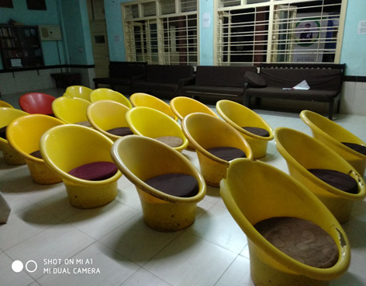
Problem Statement
Marker based navigation of the chair in a clear and obstacle-filled environment.
Ensure that the system performs well, and is therefore suitable for easy handling of messed up chair orientation.

Slide 4

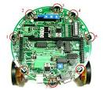
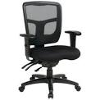
Frames from web camera
Pan web camera
Data processing into Firebird robot
Main loop
Receive frames from camera
Detection of ArUco Marker
Pan Webcam
Set flag for chair localization
Data processing into the server PC
Set flag for chair localization
Chair_localization thread
Checks flag value
Issues command to Chair
Sends move movement to chair through zigbee

Slide 5
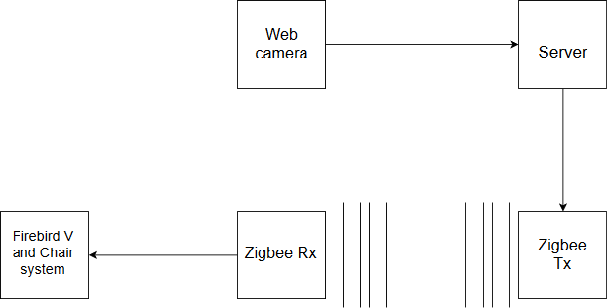
Abstract Block Diagram

Slide 6
Requirements
Hardware
Chair (Plastic Stool)
Mechanical System (Spring Actuated)
Firebird (with omnidirectional wheels)
ArUco Marker
Camera
Zigbee module
Software
C, C++, Python
Firebird libraries, ArUco libraries
Open Cv

Slide 7
Challenges
Marker detection using ArUco
Set up communication between firebird robot and server computer
Path Calculation for navigation
Accurate mapping of real movement of chair
Power constraints
Designing of mechanical set-up to establish on existing chairs.

Slide 8
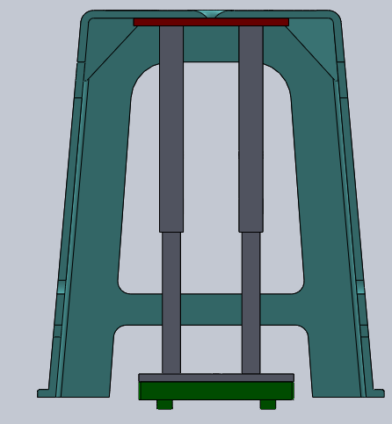
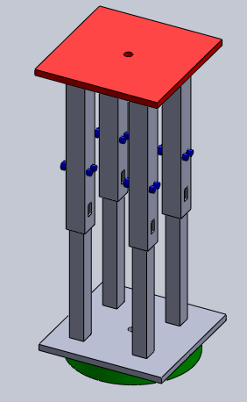
Mechanical Design

Slide 9
Deliverables
Mechanism for the localization of chair from its disoriented location.
Algorithm for navigation as well its orientation
Smart solution for the chair to better communication between speaker and the audience

Slide 10
Test Strategy

Slide 11
Timeline
Date | Task to be completed
21st March | Familiarizing with Firebird platform and ArUco
28th March | Marker detection using webcam and Firebird, study of path calculation for navigation
4th April | Procurement and Building of prototype
11th April | Testing Phase

Slide 12
2nd Demo
(05-04-2018)

Slide 13
Work done till date
ArUco code generation
Detection of ArUco using webcam
Fetching co-ordinates for present location of the Firebird
Wireless transmission of fetched co-ordinates using Zigbee for further navigation of the Firebird.

Slide 14
3rd Demo
(16-04-2018)

Slide 15
Abstract Block Diagram

Slide 16
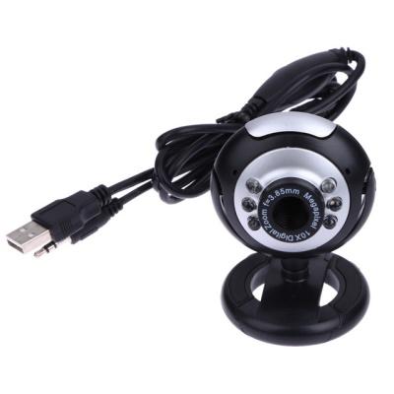

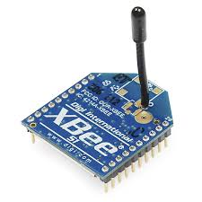
SUBSYSTEMS
ArUco MARKER detection and decision making
FIREBIRD-V
COMMUNICATION

Slide 17
FIREBIRD-V NAVIGATION
Rotatory encoders / Position encoders
Motor control
UART Xbee receiver

Slide 18
ArUco GENERATION & DETECTION AND DICISION MAKING
Generation of 5x5 ArUco marker
Detection of multiple markers
Sending results to robot via USB PORT connected to Xbee

Slide 19
COMMUNICATION
Configuration of Xbee coordinates and end device
Sending up PAN IDs & device address

Slide 20
SERVER SIDE ALGORITHM
Read Camera
Get Position
Compare with Destination
No
Is Destination
reached
Yes
STOP

Slide 21
MESSAGE PASSING & INTERPRETATION
AT FIREBIRD
MESSAGE | ACTION
A | Rotate Right by 5º
R | Turn 90º Right
L | Turn 90º Left
F | Move forward 10mm

Slide 22
Expected Output:
Firebird robot initially placed in any orientation to rotate and align to reference and navigate to destination
Output :
It reaches close to predefined destination with some errors

Slide 23
Acknowledgments
Prof. Kavi arya
Eyantra Lab :
Piyush
Fayaz
Naveen
Simranjeet
Lohit

